Slide 1
Monte Carlo Methods
Hongning Wang
CS@UVA

Slide 2
Outline
A brief overview of Monte Carlo methods
Monte Carlo prediction
On-policy Monte Carlo control
Off-policy Monte Carlo control

Slide 3
Monte Carlo methods
Where the famous Monte Carlo Casino locates!

Slide 4
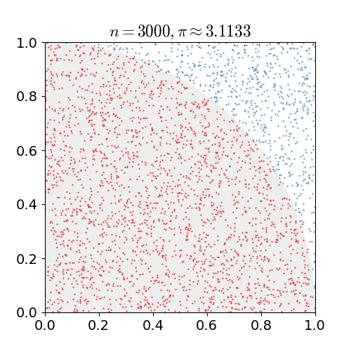
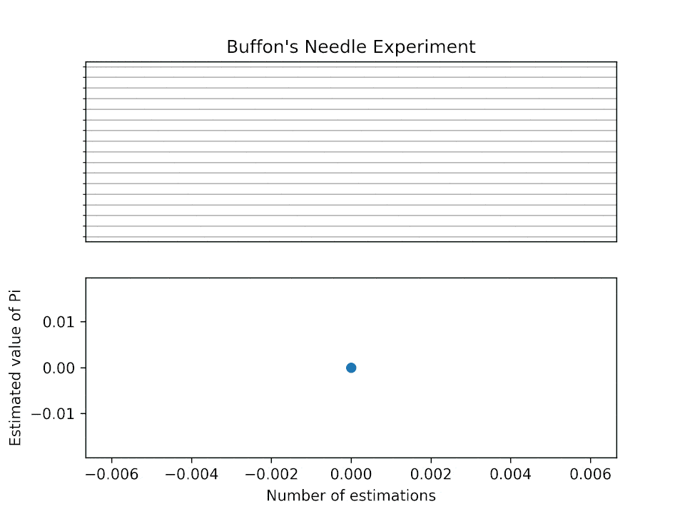
Monte Carlo methods
A family of methods that rely on repeated random sampling to obtain numerical results

Slide 5
Recap: value iteration
Perform policy improvement right after one iteration of policy evaluation
Policy improvement
Policy evaluation for only one step
No explicit policy, which is induced by the updated value function (i.e., take the best action)

Slide 6
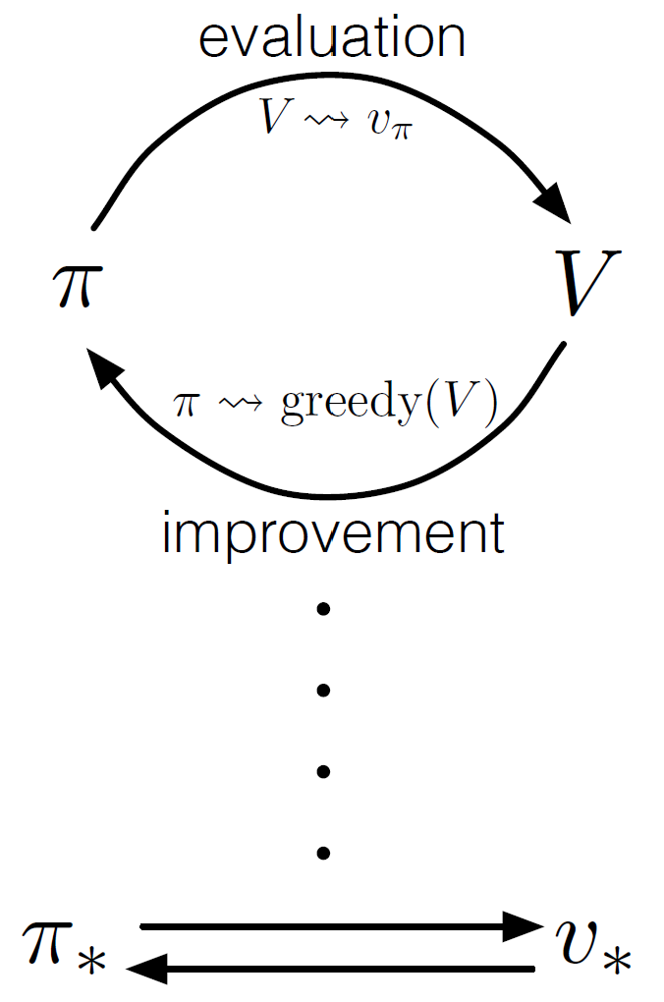
Recap: generalized policy iteration
Any evaluation method
Various ways to perform policy evaluation
Asynchronous policy evaluation
Finite step policy evaluation
Various ways to improve the current policy
For all states
At least one state
A subset of states
Any improvement method
Generalized EM algorithm?

Slide 7
Monte Carlo methods
A family of methods that rely on repeated random sampling to obtain numerical results
Define the input space
Independently sample from the desired distribution over the input space
Aggregate the samples for evaluation
key step!

Slide 8
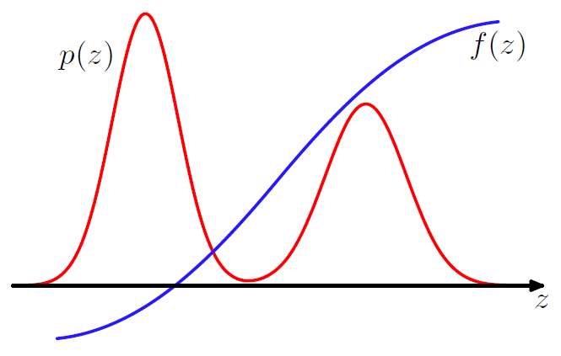
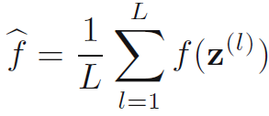
Uniform notion for sampling
Compute expectation
Basic idea: approximate by a finite sum
When f(z) is the delta function, expectation becomes probability
Get $\{z^{(l)}\}$ with respect to $p(z)$
Figure credit: Bishop, “Pattern Recognition and Machine Learning”, 2nd edition, p524

Slide 9
Sampling is not easy
Recall the problem of expectation computation
Instead of get $\{z^{(l)}\}$ with respect to $p(z)$, let’s use some simple scheme to get a set of $\{z^{(l)}\}$ (e.g., using fixed grids), and compute
Limitations:
Does not scale with high dimensions
$p(z)$ might concentrate on some small regions, fixed sampling scheme might waste a lot of samples

Slide 10
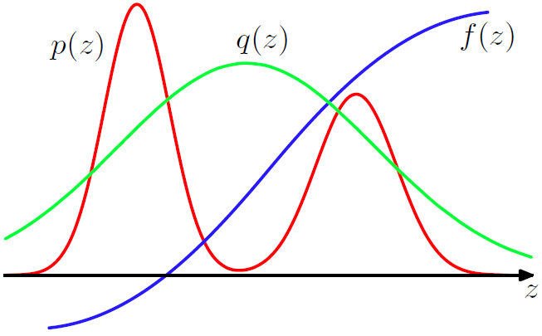
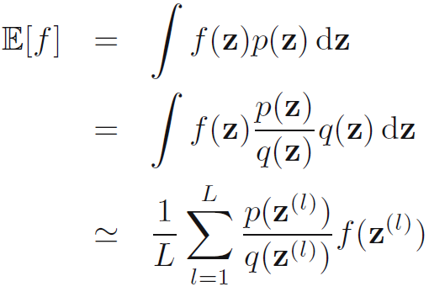
Importance sampling
Let’s sample from a proposal distribution and reweigh its contribution to the expectation
What if we cannot directly evaluate this?
Assumption: both distributions have the same support!
Importance weight

Slide 11
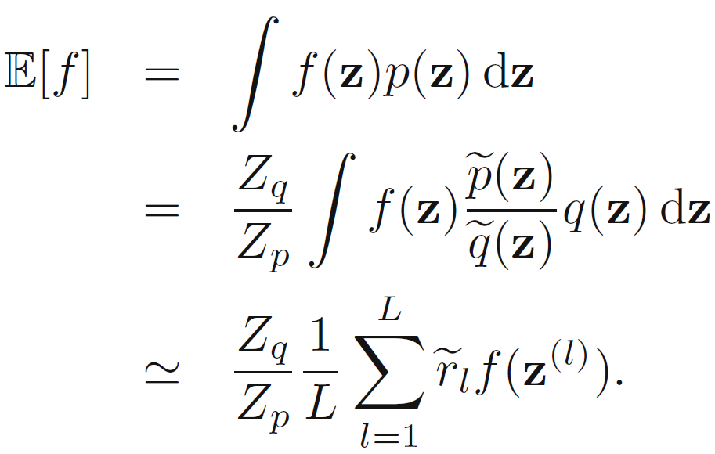
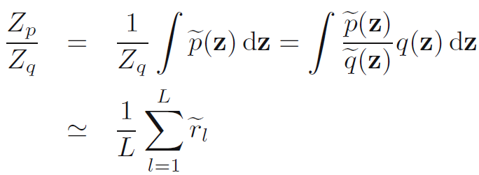
Importance sampling
If we can only evaluate and up to a constant
and

Slide 12
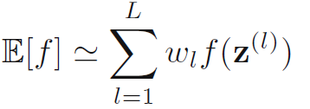
Importance sampling
If we can only evaluate and up to a constant
and
Proposal distribution still has to be close the target distribution to increase the fidelity of expectation estimation
where,
Weighted importance sampling

Slide 13
Monte Carlo prediction
Policy evaluation (a.k.a prediction)
In dynamic programming (therefore, model-based)
All given; but what if the model is not provided?

Slide 14
Monte Carlo prediction
Policy evaluation (a.k.a prediction)
Assume the environment is accessible
Interact with the environment to get experiences
Use the experiences to estimate the values
Sampling
Evaluation
$$v_{π}\left(s_{t}\right)=E_{π}\left[R_{t+1}+γR_{t+2}+γ^{2}R_{t+3}+…+γ^{T−1}R_{T}|s_{t}\right]$$
With respect to the given policy $π(a|s)$!
$${{\{s}_{n,t},a_{n,t},R_{n,t},s_{n,t+1},a_{n,t+1},R_{n,t+1},……,s_{n,T},a_{n,T},R_{n,T}\}}_{n=1}^{N}$$
$$v_{π}\left(s_{t}\right)=\frac{1}{N}\sum_{n=1}^{N}{\left[R_{n,t}+γR_{n,t+1}+γ^{2}R_{n,t+2}+…+γ^{T−1}R_{n,T}|s_{t}\right]}$$

Slide 15
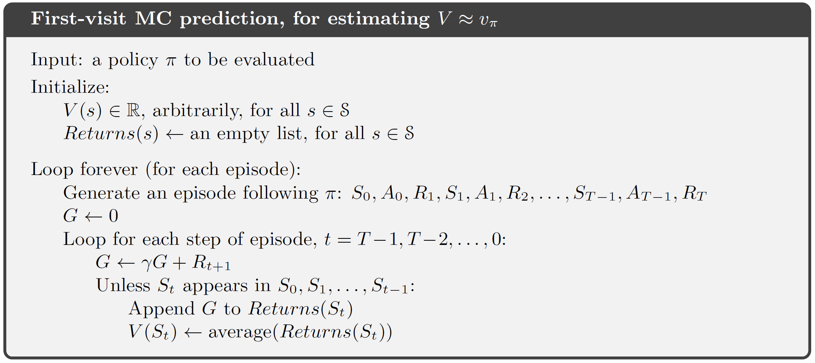
Monte Carlo prediction
To ensure the collected samples are i.i.d
Only for episodic tasks!
?
Move backwards to collect statistics
Update only happens after each episode, not each action!

Slide 16
Monte Carlo prediction
Chernoff-Hoeffding bound
Good properties
Unbiased estimate of value function
The estimate’s standard deviation converges with a rate of $o(\frac{1}{\sqrt{N}})$
Estimating value in a single state is independent from the total number of states

Slide 17
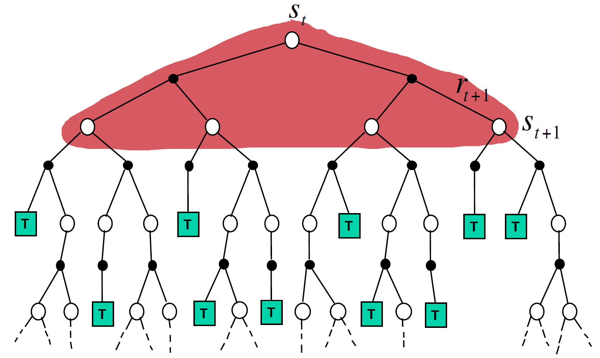
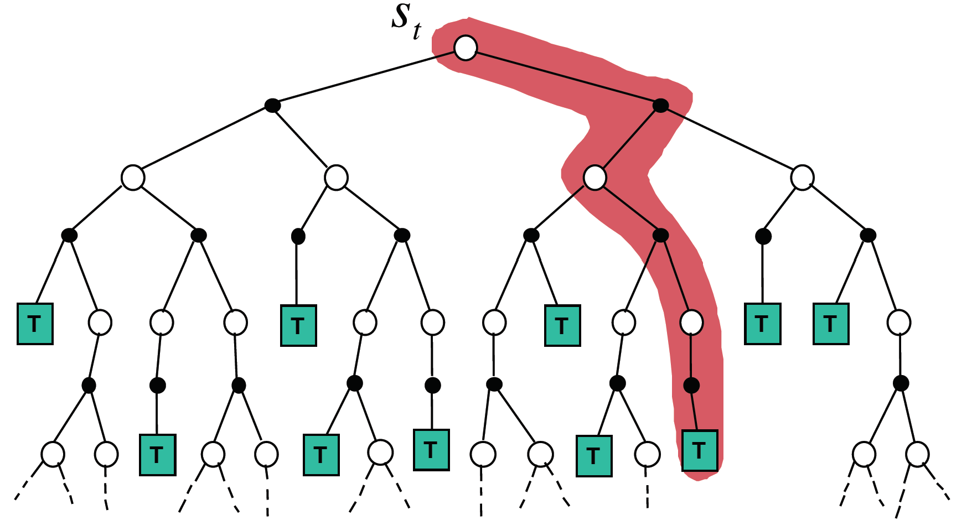
Comparisons
Monte Carlo methods
Model-free
Evaluation of one state is independent from evaluation on other states
Dynamic programming
Model-based
Evaluation of states depends on each other
Figure credit: David Silver, “Model-Free Prediction”

Slide 18
Action value function for control
For policy improvement, state value function alone is insufficient
Recall in dynamic programming, we need reward of each action and value of next state
$$v\left(g\right)=−2$$
$$v\left(t\right)=0$$
$$v\left(d\right)=−4$$
2
g
2
1
t
b
d
4
$$v\left(b\right)=−5$$
4
2
a
4
9
$$v\left(a\right)=−9$$
$$π^{∗}\left(a\right)=→b$$
f
2
c
e
5
$$v\left(f\right)=−2$$
3
$$v\left(e\right)=−7$$
$$π^{∗}\left(f\right)=→t$$
$$v\left(c\right)=−8$$
$$π^{∗}\left(c\right)=→d$$

Slide 19
Recap: Monte Carlo prediction
Policy evaluation (a.k.a prediction)
Assume the environment is accessible
Interact with the environment to get experiences
Use the experiences to estimate the values
Sampling
Evaluation
$$v_{π}\left(s_{t}\right)=E_{π}\left[R_{t+1}+γR_{t+2}+γ^{2}R_{t+3}+…+γ^{T−1}R_{T}|s_{t}\right]$$
With respect to the given policy $π(a|s)$!
$${{\{s}_{n,t},a_{n,t},R_{n,t},s_{n,t+1},a_{n,t+1},R_{n,t+1},……,s_{n,T},a_{n,T},R_{n,T}\}}_{n=1}^{N}$$
$$v_{π}\left(s_{t}\right)=\frac{1}{N}\sum_{n=1}^{N}{\left[R_{n,t}+γR_{n,t+1}+γ^{2}R_{n,t+2}+…+γ^{T−1}R_{n,T}|s_{t}\right]}$$

Slide 20
Recap: Monte Carlo prediction
To ensure the collected samples are i.i.d
Only for episodic tasks!
?
Move backwards to collect statistics
Update only happens after each episode, not each action!

Slide 21
Action value function
It gets complicated when using Monte Carlo methods
Sample episodes for each state-action pairs
As estimates are independent from each other, if one pair is never visited before, its estimate will never be updated
Exploration matters!
On-policy methods
Off-policy methods
What we learnt in bandits applies!

Slide 22
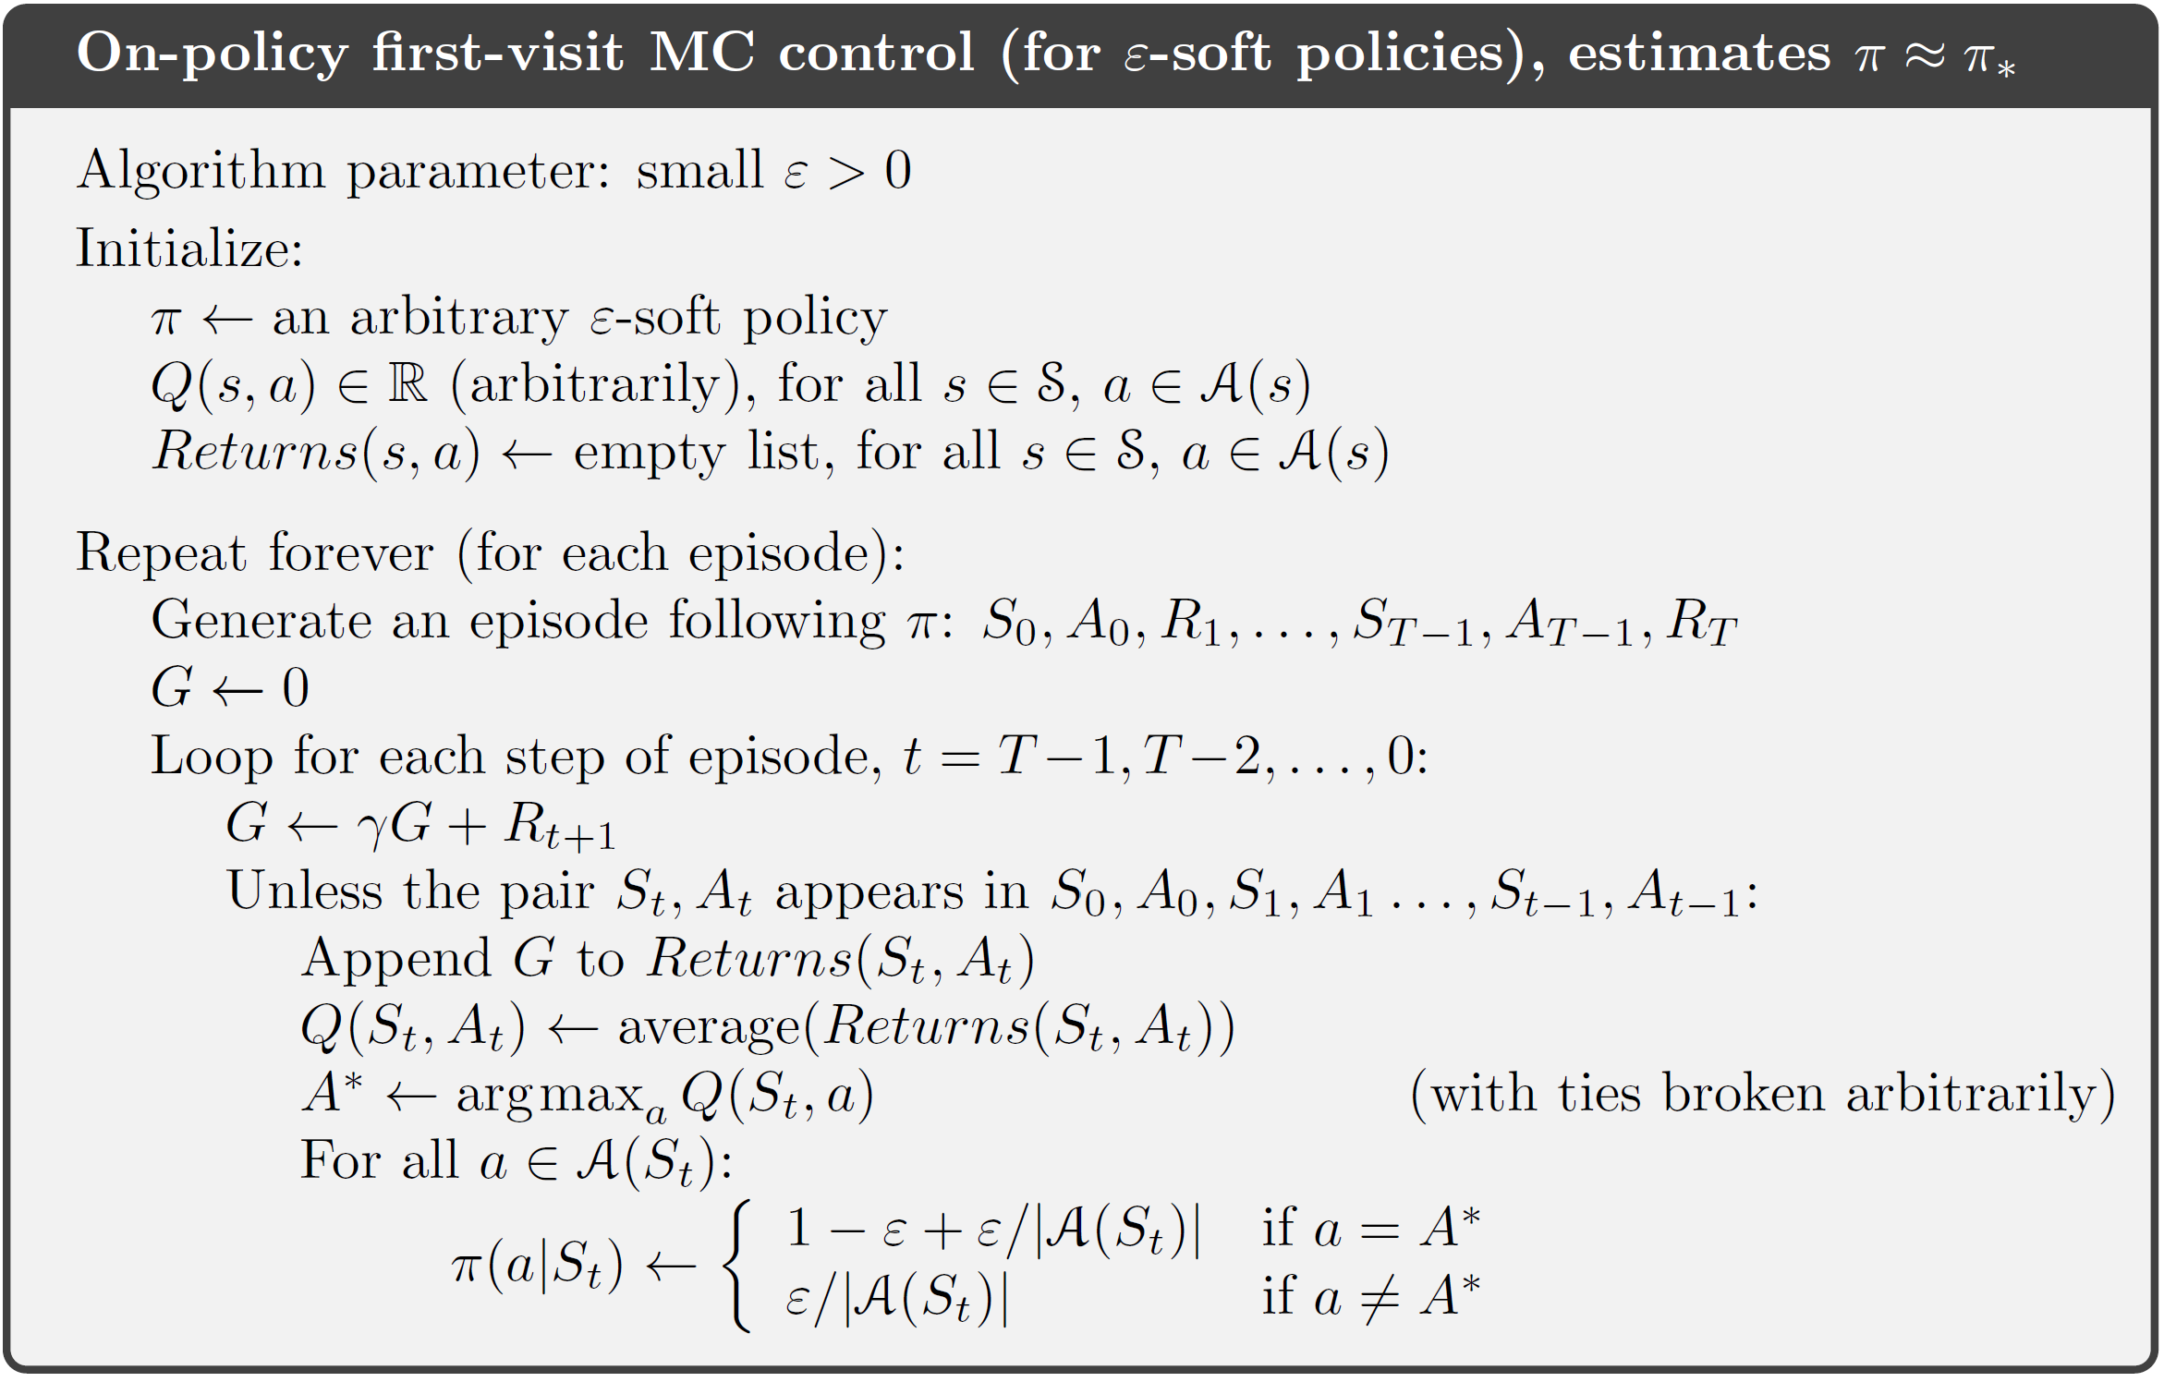
On-Policy MC control
$$π\left(a | s\right)≥\frac{ε}{\left|A\left(s\right)\right|}, ∀s,a$$
All state-action pairs will be taken with a non-zero probability
Can we use UCB here?
$ε$-greedy

Slide 23
On-Policy MC control
Policy improvement is guaranteed

Slide 24
Recap: On-Policy MC control
Policy improvement is guaranteed

Slide 25
Off-Policy MC control
Learning values from actions taken by a different policy
Behavior policy $b(a|s)$ $→$ used to interact with environment
Target policy $π(a|s)$ $→$ to be used later
Why?
Oftentimes it is expensive to directly interact with environment
Utilize existing offline data
“Target policy”
“Behavior policy”
Coverage assumption:
$$π\left(a | s\right)>0⇒b\left(a | s\right)>0$$
Goal: estimate the importance weight

Slide 26
Off-Policy MC evaluation
Use importance sampling to reweigh experiences
As the environment follows an MDP
The importance weight is the product of the series of actions under two policies
Source of large variance!

Slide 27
Off-Policy MC evaluation
Use importance sampling to reweigh experiences
Return of target policy under the behavior policy’s trajectories
By behavior policy!

Slide 28
Off-Policy MC control
Incremental update
Why?
Why?

Slide 29
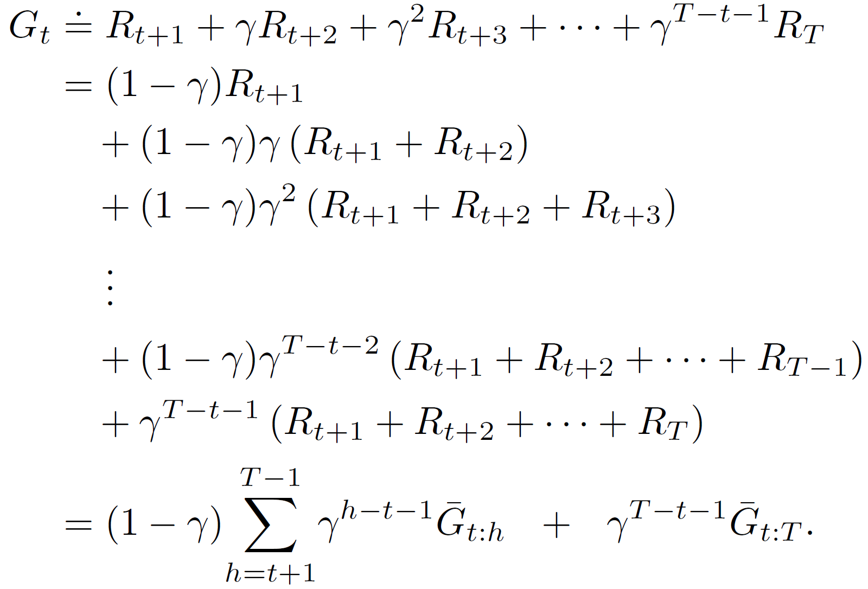
Discounting-aware importance sampling
Direct application of importance sampling causes high variance in value estimation
Importance weight is a product of a series of probability ratios
Return is a sum of an exponentially decaying series!
Will be small!
Flat partial return ${\overline{G}}_{t:h}$

Slide 30
Discounting-aware importance sampling
Direct application of importance sampling causes high variance in value estimation
Importance weight is a product of a series of probability ratios
Return is a sum of an exponentially decaying series!
Using the exponentially (small) discounting factor to balance the exponentially (large) importance weight
strike a balance

Slide 31
Per-decision importance sampling
The same importance weight for every action in an episode?
A closer look
Under behavior policy

Slide 32
Per-decision importance sampling
The importance weight only needs to be counted till the current action
Apply it to reweigh return
The subsequent actions do not affect the reward of this step!
strike a balance
A much shorter series to compute product

Slide 33
Takeaways
A model-free RL solution
Learns from experiences
Monte Carlo control is based on generalized policy iteration in an episode-by-episode basis
On-policy Monte Carlo methods
Exploration matters
Off-policy Monte Carlo methods
Variance control matters

Slide 34
Suggested readings
Chapter 5, Monte Carlo Methods
Bishop, “Pattern Recognition and Machine Learning”, 2nd edition, Chapter 11, Sampling Methods

